Slide 1
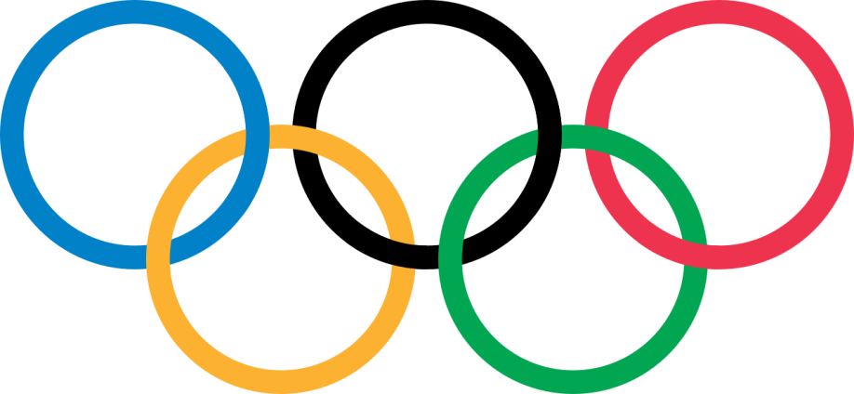
Exploratory Data Analysis on 120 Years of Olympic History
By,
Venkatesan Murugesan

Slide 2
Why this dataset?
Now a days more than 200 countries are participating in Olympics which consist more than 11000 players
Many of the countries failed to grab the medal.
So I decided to analyse medal won by each country, mainly about our country.

Slide 3
About Olympics
IOC – International Olympics Committee
The five rings represented the five participating continents of the time:
Africa,
Asia,
America,
Europe,
Oceania.
Motto:
Faster
Higher
Stronger

Slide 4
About Dataset
This is a historical dataset on the modern Olympic Games, including all the Games from Athens 1896 to Rio 2016.
This dataset consist 120 years of Olympic history with 2,71,116 rows and 15 columns
In 120 years Olympics happened in 35 Years which includes 51 Seasons.
Olympics happened in 42 different cities in those period
Summer and Winter seasons held up in same year in 1924 to 1992
After that summer and winter season games comes once in 4 years. i.e., 1994 winter, 1996 summer like that
Olympics was cancelled 3 years because of world war.

Slide 5
Column details
The columns are:
ID - Unique number for each athlete
Name - Athlete's name
Sex - M or F
Age - Integer
Height - In centimeters
Weight - In kilograms
Team - Team name
NOC - National Olympic Committee 3-letter code
Games - Year and season
Year - Integer
Season - Summer or Winter
City - Host city
Sport - Sport
Event - Event
Medal - Gold, Silver, Bronze, or NA

Slide 6
Objective
To analyze country count and players count participated in each season of Olympics
To analyze number of players participated and number of players got medal in each country
To analyze which country has won highest number of medals and visualize top 10 countries based on their medal count
To analyze the medal counts won by male and female and visualize them
To find out medal counts of a country based on Season, Sport, Event, Gender and type of Medal
To analyze below/above 18 age group people and their more medal counts

Slide 7
Objective
Slice our country data and store it into another data frame
Find out years and seasons which are India participated and player counts also
To analyse India's overall medal count and based on Gender also
To analyse the Medal count in each Sports
To analyse the Medal count of sport ‘Hockey’ which is our National game
To analyse India’s performance of 2016 Olympics (which is latest in dataset) and find out number of players participated and number of medals won

Slide 8
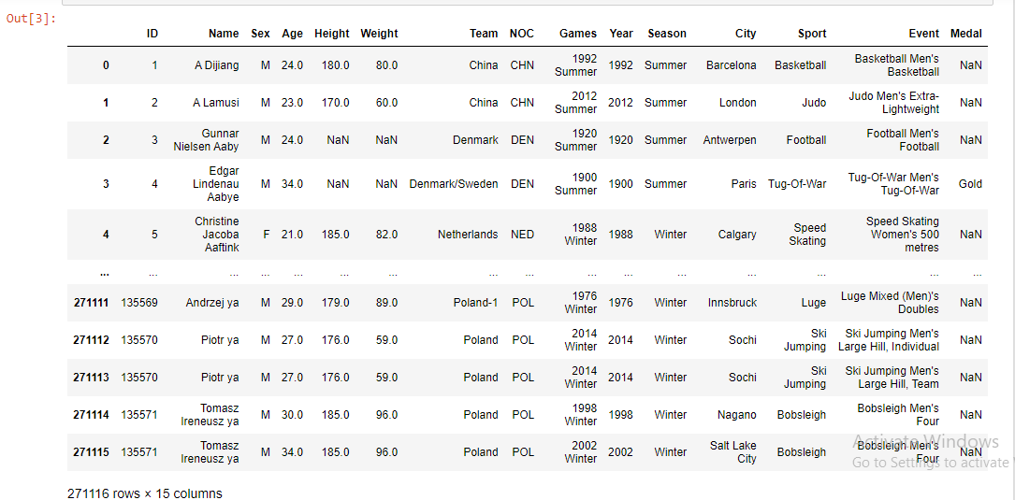
Dataset

Slide 9
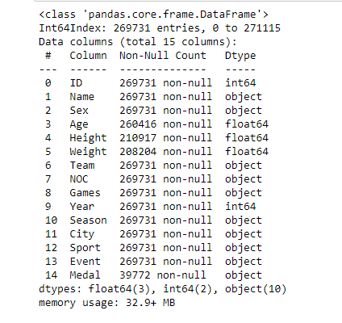
Information about Column

Slide 10
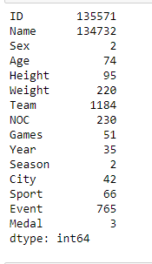
Unique values

Slide 11
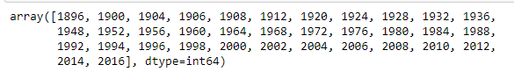
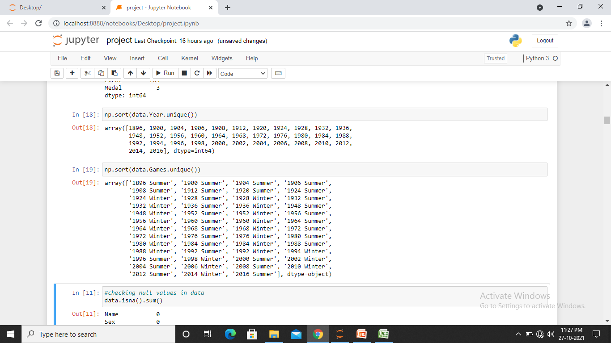
Year and Season
Olympics happened in 35 years (51 Season)
Olympics in year 1916 was cancelled due to World War – I and in year 1940 and 1944 was cancelled due to World War - II

Slide 12
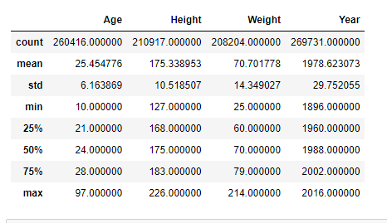
Descriptive statistics on data

Slide 13
Pre-processing
Pre-Processing includes
Removing duplicates present in dataset
Checking and Filling NA values
Setting a ID column as a index
Joining two datasets
Removing unnecessary columns
Renaming a column as per data

Slide 14
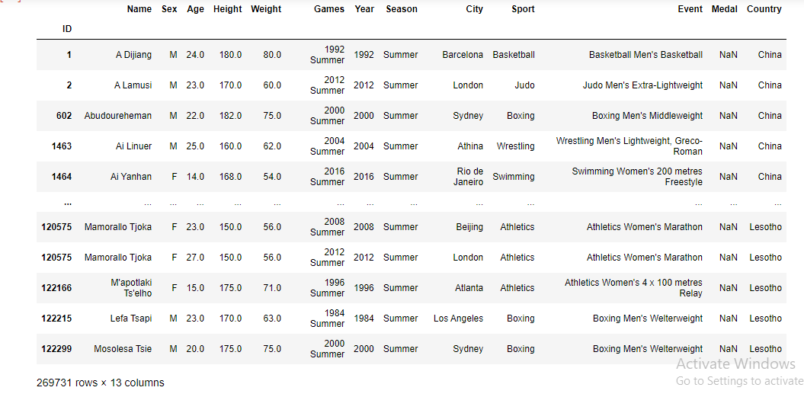
Pre-processed Data

Slide 15
Exploratory Data Analysis
EDA done using pandas library and visualization using matplotlib and seaborn
In this analysis maximum of reports are in pivot table format which is easy to understand
Reports are visualized using plots to understand more easier

Slide 16
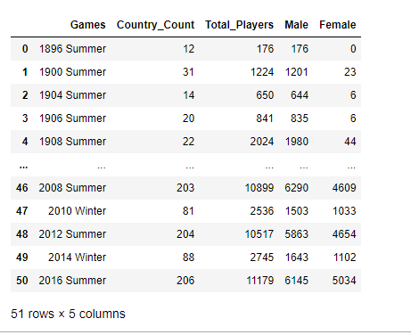
Country and Players Count

Slide 17
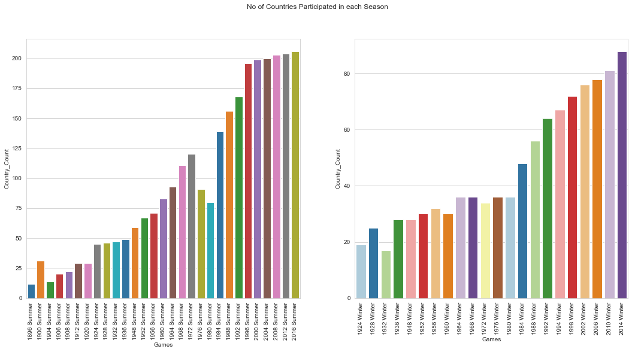
Country count

Slide 18
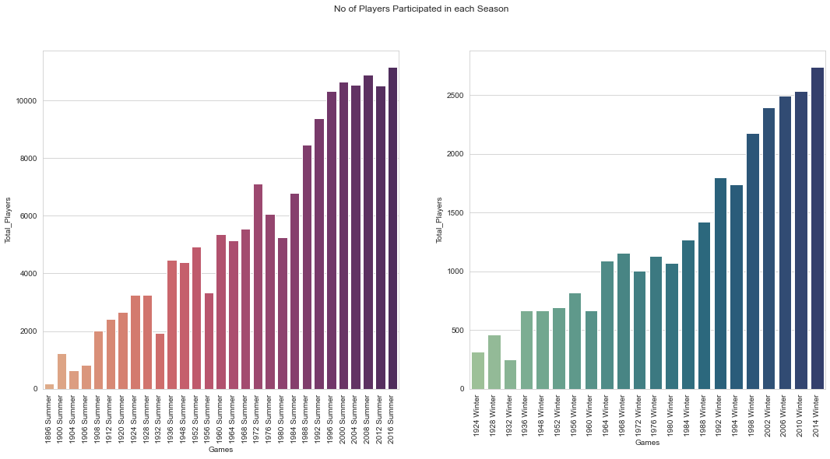
Players count

Slide 19
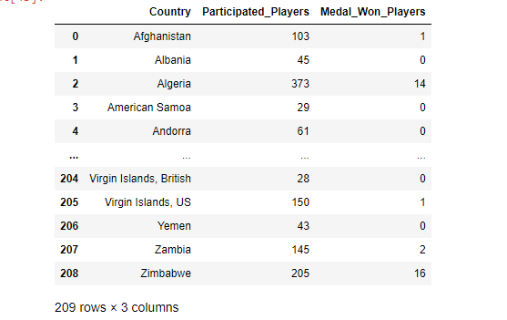
Participated and Medal Won Players

Slide 20
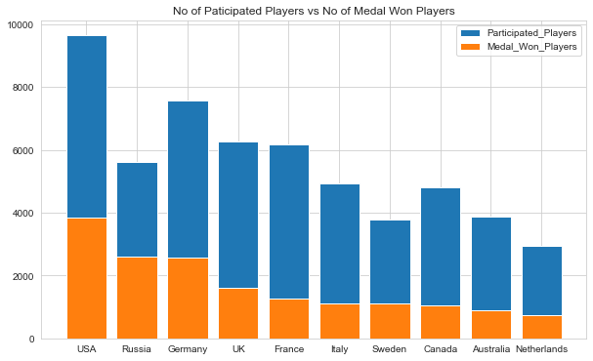
Comparison barplot

Slide 21
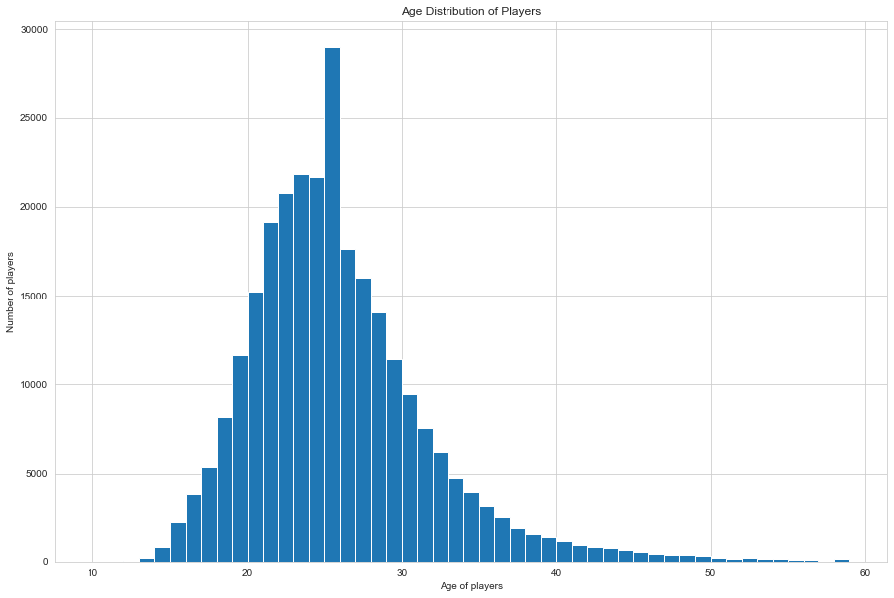
Age Distribution of Players

Slide 22
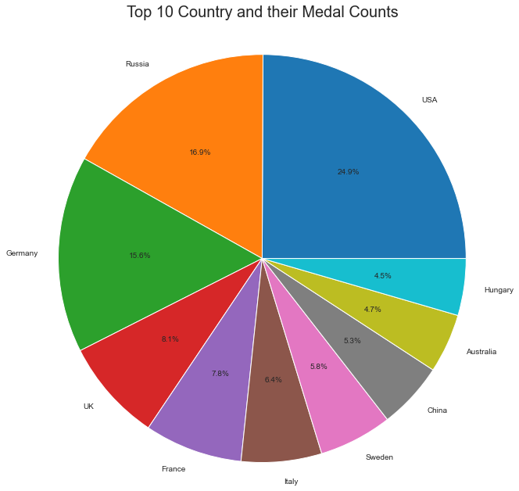
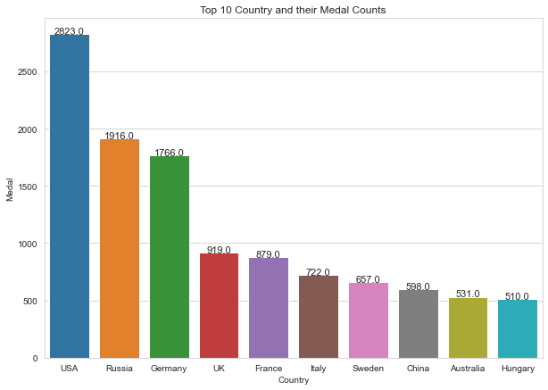
Top 10 Countries based on Medal counts
Pie Chart
Bar Chart

Slide 23
Top 10 Countries with Type of Medal
 | Country | Medal | Medal_count
0 | USA | Gold | 1131
1 | USA | Silver | 901
2 | USA | Bronze | 791
3 | Russia | Gold | 727
4 | Russia | Silver | 600
5 | Germany | Bronze | 596
6 | Germany | Silver | 592
7 | Russia | Bronze | 589
8 | Germany | Gold | 578
9 | France | Bronze | 329

Slide 24
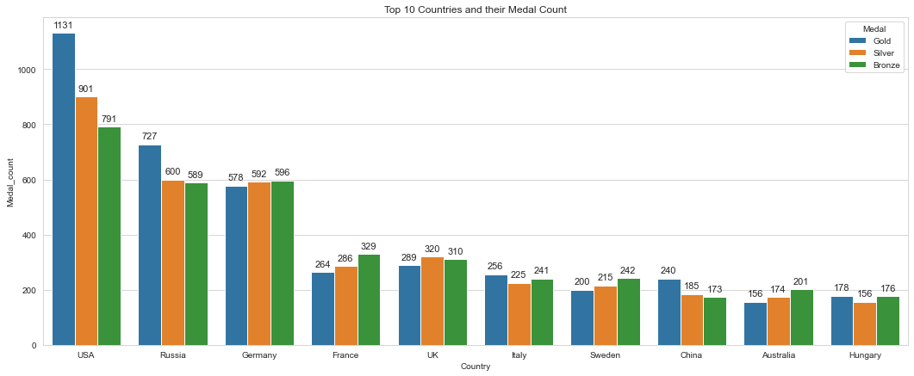
Plot for Top 10 countries with Each Medal type

Slide 25
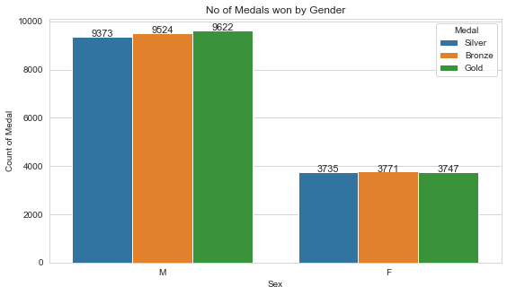
Medal count based on Gender

Slide 26
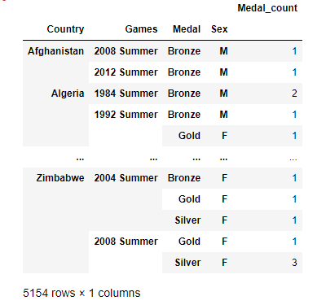
Medal count with Season and Gender

Slide 27
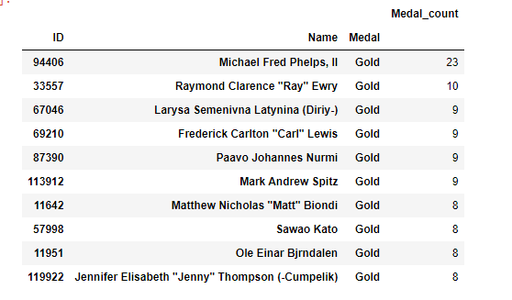
Top 10 Players based on their Medal count

Slide 28
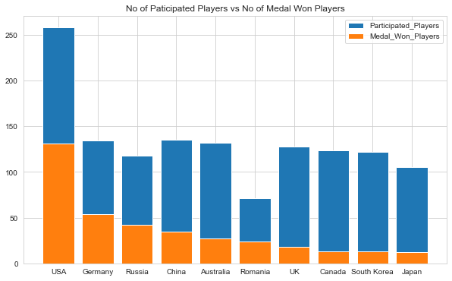
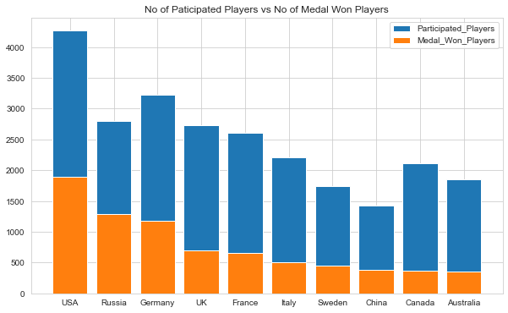
Above and Below 18 Age Players Medal Count
Age : Below 18
Age : Above 18

Slide 29
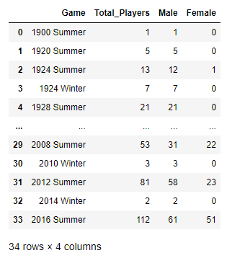
India’s Player count

Slide 30
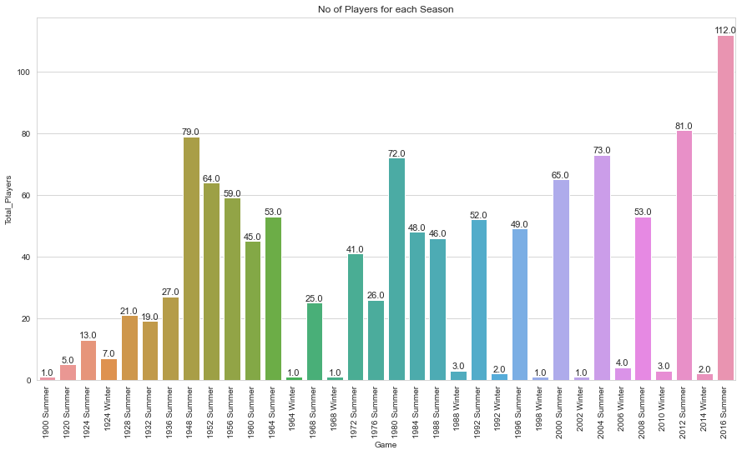
Player’s count

Slide 31
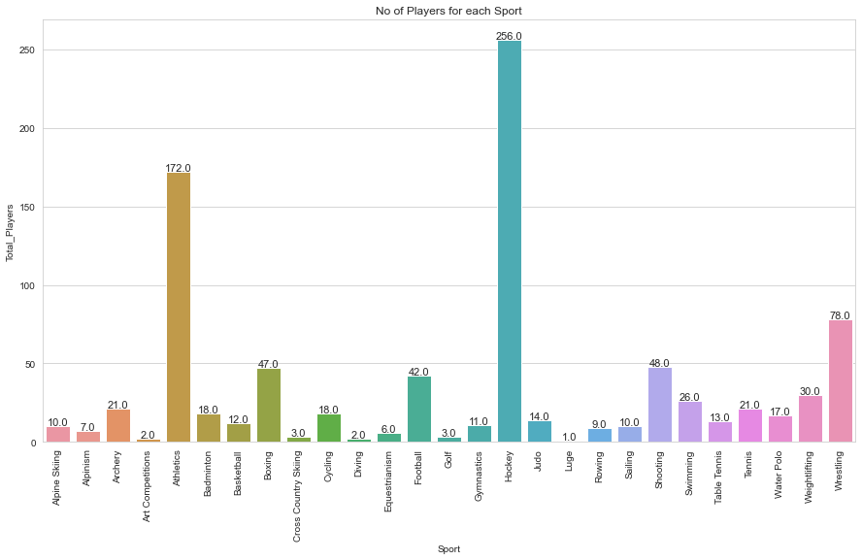
Players count for each Sport

Slide 32
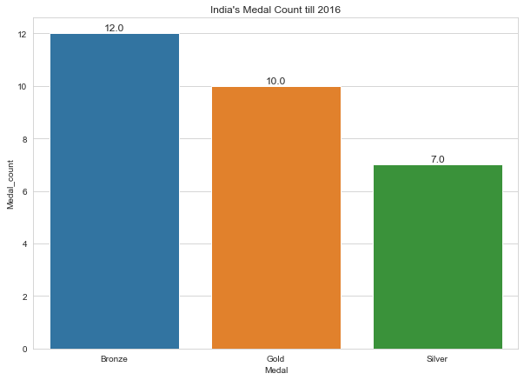
India’s Medal Count

Slide 33
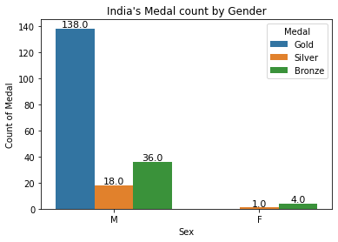
India’s Medal count based on Gender

Slide 34
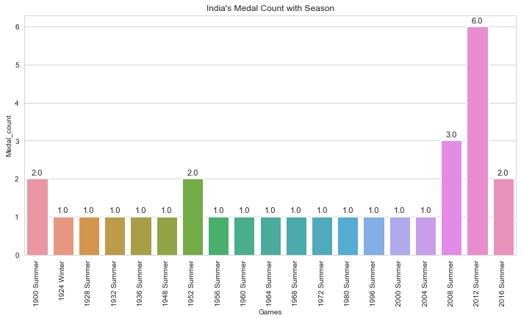
India’s Medal count with Season

Slide 35
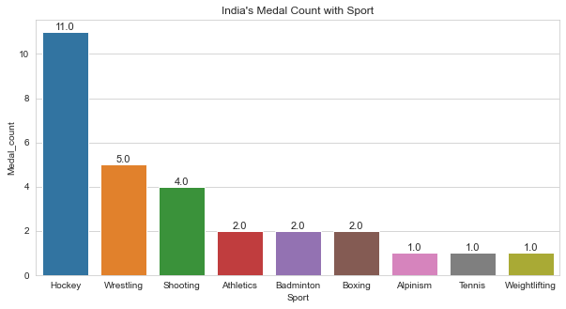
India’s Medal count for Every Sport

Slide 36
Conclusion
Maximum of 206 countries and 11179 players are participated in 2016 Summer Olympics
USA has max no of participated players : 9653 and max no of medal won players : 3836
USA also had won 5637 medals including
Gold : 2638,
Bronze : 1358,
Silver : 1641.
USA has maximum number of both above and below 18 years of age players
Below 18:
Participated Players : 455, Medal Won Players : 209, Medal Count : 296
Above 18:
Participated Players : 9355, Medal Won Players : 3690, Medal Count : 5341

Slide 37
Conclusion
India participated in 34 seasons of Olympics
In 2016 Olympics 112 players were participated in 27 different sports
Hockey has the most number of players i.e, 256
India won 197 medals in that period. They are
Gold : 138
Bronze : 40
Silver : 19
India won 173 medals in Hockey
In 2016 Summer Olympics India won 2 medals (1 Silver and 1 Bronze)

Slide 38
Limitations
Team name : it was mismatched with country
There were 1385 duplicate rows
There were missing values in Age, Height, Weight columns
Soviet Union is considered as Russia. It consist 15 republics like Russia, Ukraine, Georgia, etc.

Slide 39
Queries...

Slide 40
Thank You...

